Slide 1
Modelling Interactions and Behaviour
Sequence Diagram

Slide 2
Interaction Diagrams
Interaction diagrams are used to model the dynamic aspects of a software system
  They help you to visualize how the system runs.
  An interaction diagram is often built from a use case and a class diagram.
    The objective is to show how a set of objects accomplish the required interactions with an actor.
Notes:
we look at how to model system dynamics, focusing on two
aspects: interactions and behavior. An interaction model shows a set of actors
and objects interacting by exchanging messages. A behavior model shows how
an object or system changes state in reaction to a series of events

Slide 3
Interactions and messages
  Interaction diagrams show how a set of actors and objects communicate with each other to perform:
    The steps of a use case, or
    The steps of some other piece of functionality.
  The set of steps, taken together, is called an interaction.
  Interaction diagrams can show several different types of communication.
    E.g. method calls, messages send over the network
    These are all referred to as messages.
Notes:
Interaction diagrams
Interaction diagrams are used to model the dynamic aspects of a software
system – they help to visualize how the system runs. They show how a set of
actors and objects communicate with each other to perform the steps of a use
case, or of some other piece of functionality. The set of steps, taken together, is
called an interaction.
Interaction diagrams can show several different types of communication.
These include messages exchanged over a network, simple procedure calls, and
commands issued by an actor through the user interface. Collectively, these are
referred to as messages.

Slide 4
Elements found in interaction diagrams
  Instances of classes
    Shown as boxes with the class and object identifier underlined
  Actors
    Use the stick-person symbol as in use case diagrams
  Messages
    Shown as arrows from actor to object, or from object to object

Slide 5
Creating interaction diagrams
You should develop a class diagram and a use case model before starting to create an interaction diagram.
  Important interaction diagrams:
    Sequence diagrams
    Communication diagrams
    Timing diagrams

Slide 6
Sequence diagrams
A sequence diagram shows the sequence of messages exchanged by the set of objects performing a certain task
  The objects are arranged horizontally across the diagram.
  An actor that initiates the interaction is often shown on the left.
  The vertical dimension represents time.
  A vertical line, called a lifeline, is attached to each object or actor.
  The lifeline becomes a broad box, called an activation box during the live activation period.
  A message is represented as an arrow between activation boxes of the sender and receiver.
    A message is labelled and can have an argument list and a return value.
Notes:
The objects are arranged from left to right across the diagram – an actor that
initiates the interaction is often shown on the left. The vertical dimension
represents time. The top of the diagram is the starting point, and time
progresses downwards towards the bottom of the diagram. A vertical dashed
line, called a lifeline, is attached to each object or actor. The lifeline becomes a
box, called an activation box, during the period of time that the object is
performing computations. The object is said to have live activation during these
times.
A sequence diagram shows object interactions arranged in time sequence It depicts the objects involved in the scenario and the sequence of messages exchanged between the objects needed to carry out the functionality of the scenario. Sequence diagrams are typically associated with use case realizations in the Logical View of the system under development. Sequence diagrams are sometimes called event diagrams or event scenarios
Messages, written with horizontal arrows with the message name written above them, display interaction. Solid arrow heads represent synchronous calls, open arrow heads represent asynchronous messages, and dashed lines represent reply messages.^{[1]} If a caller sends a synchronous message, it must wait until the message is done, such as invoking a subroutine. If a caller sends an asynchronous message, it can continue processing and doesn’t have to wait for a response. Asynchronous calls are present in multithreaded applications, event-driven applications and in message-oriented middleware. Activation boxes, or method-call boxes, are opaque rectangles drawn on top of lifelines to represent that processes are being performed in response to the message
A message can flow in any direction; from left to right, right to left or back to the Message Caller itself. While you can describe the message being sent from one object to the other on the arrow, with different arrowheads you can indicate the type of message being sent or received.

Slide 7
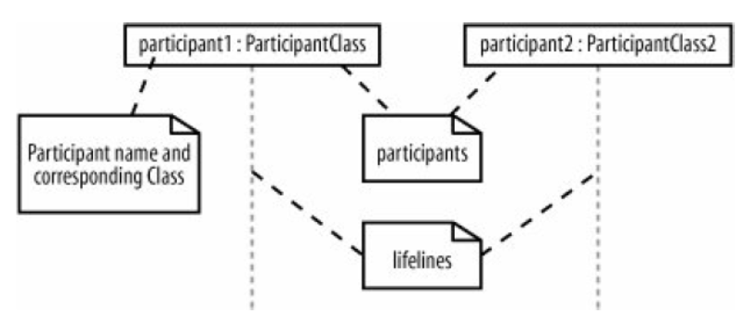
Notes:
Time is an important facctor. Time is about order, not the duration.

Slide 8
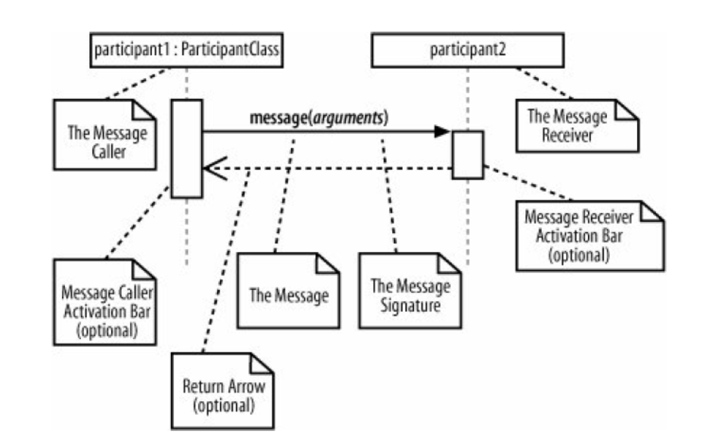
Notes:
Activation bar : To show that a participant is active, doing some thing we can use activation bars. Are optional
A sequence diagram shows, as parallel vertical lines (lifelines),
The message arrow comes with a description, which is known as a message signature, on it. The format for this message signature is below. All parts except the message_name are optional.
attribute = message_name (arguments): return_type
Synchronous message
As shown in the activation bars example, a synchronous message is used when the sender waits for the receiver to process the message and return before carrying on with another message. The arrowhead used to indicate this type of message is a solid one, like the one below.
Asynchronous message
An asynchronous message is used when the message caller does not wait for the receiver to process the message and return before sending other messages to other objects within the system. The arrowhead used to show this type of message is a line arrow like shown in the example below.
Return message
A return message is used to indicate that the message receiver is done processing the message and is returning control over to the message caller. Return messages are optional notation pieces, for an activation bar that is triggered by a synchronous message always implies a return message.
Tip: You can avoid cluttering up your diagrams by minimizing the use of return messages since the return value can be specified in the initial message arrow itself.
Participant creation message
Objects do not necessarily live for the entire duration of the sequence of events. Objects or participants can be created according to the message that is being sent.
The dropped participant box notation can be used when you need to show that the particular participant did not exist until the create call was sent. If the created participant does something immediately after its creation, you should add an activation box right below the participant box
Participant destruction message
Likewise, participants when no longer needed can also be deleted from a sequence diagram. This is done by adding an ‘X’ at the end of the lifeline of the said participant.
Reflexive message
When an object sends a message to itself, it is called a reflexive message. It is indicated with a message arrow that starts and ends at the same lifeline

Slide 9
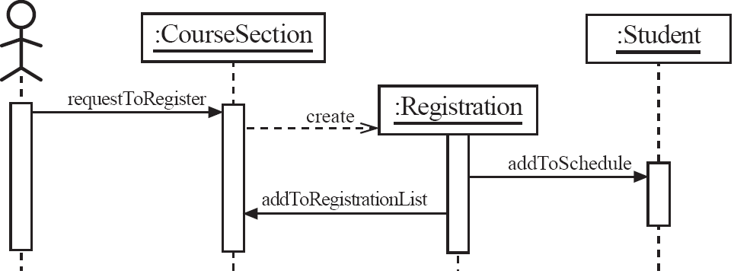
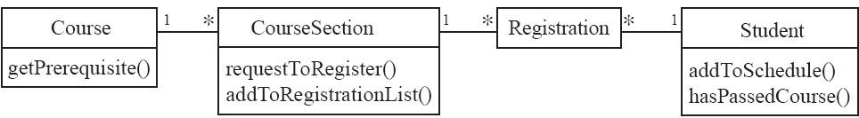
Sequence diagrams – an example
Notes:
In simpler words, a sequence diagram shows different parts of a system work in a ‘sequence’ to get something done.
A sequence diagram shows the sequence of messages exchanged by the set of
objects (and optionally an actor) performing a certain task

Slide 10
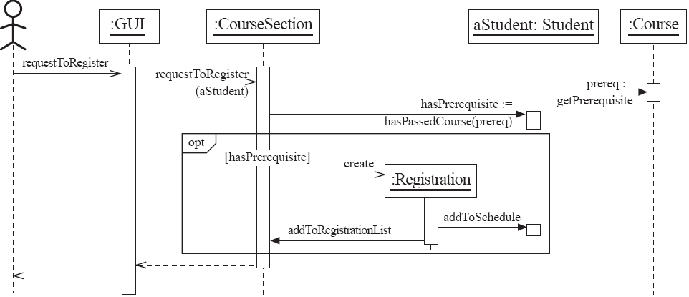
Sequence diagrams – same example, more details
Notes:
As with class diagrams, interaction diagrams can be drawn at various levels of detail.
idea of interaction fragments^{[2]} which represent smaller pieces of an enclosing interaction. Multiple interaction fragments are combined to create a variety of combined fragments,^{[3]} which are then used to model interactions that include parallelism, conditional branches, optional interactions
Manage complex interactions with sequence fragments
A sequence fragment is represented as a box that frames a section of interactions between objects (as shown in the examples below) in a sequence diagram.
It is used to show complex interactions such as alternative flows and loops in a more structured way. On the top left corner of the fragment sits an operator. This – the fragment operator – specifies what sort of a fragment it is.
Alternatives
The alternative combination fragment is used when a choice needs to be made between two or more message sequences. It models the “if then else” logic.
The alternative fragment is represented by a large rectangle or a frame; it is specified by mentioning ‘alt’ inside the frame’s name box (a.k.a. fragment operator).
To show two or more alternatives, the larger rectangle is then divided into what is called interaction operands using a dashed line, as shown in the sequence diagram example above. Each operand has a guard to test against and it is placed at the top left corner of the operand.
options
The option combination fragment is used to indicate a sequence that will only occur under a certain condition, otherwise, the sequence won’t occur. It models the “if then” statement.
Similar to the alternative fragment, the option fragment is also represented with a rectangular frame where ‘opt’ is placed inside the name box.
Unlike the alternative fragment, an option fragment is not divided into two or more operands. Option’s guard is placed at the top left corner.

Slide 11
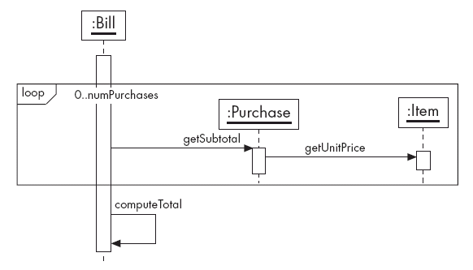
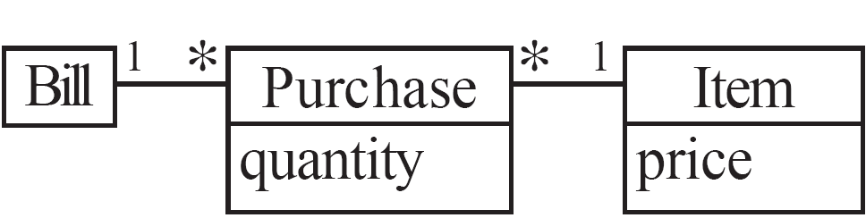
Sequence diagrams – an example with replicated messages
Notes:
Loops
Loop fragment is used to represent a repetitive sequence. Place the words ‘loop’ in the name box and the guard condition near the top left corner of the frame.
In addition to the Boolean test, the guard in a loop fragment can have two other special conditions tested against. These are minimum iterations (written as minint = [the number] and maximum iterations (written as maxint = [the number]).
If it is a minimum iterations guard, the loop must execute not less than the number mentioned, and if it is a maximum iterations guard, the loop mustn’t execute more than the number indicated
Reference Fragment
You can use the ref fragment to manage the size of large sequence diagrams. It allows you to reuse part of one sequence diagram in another, or in other words, you can reference part of a diagram in another diagram using the ref fragment.
To specify the reference fragment, you have to mention ‘ref’ in the name box of the frame and the name of the sequence diagram that is being referred to inside the frame.

Slide 12
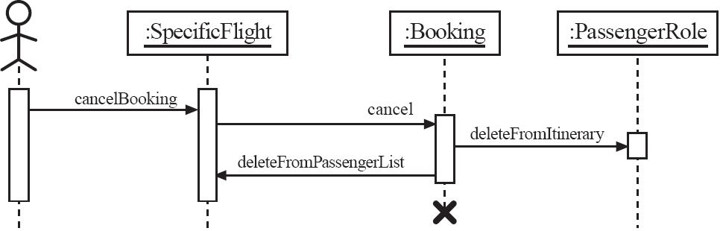
Sequence diagrams – an example with object deletion
  If an object’s life ends, this is shown with an X at the end of the lifeline
Notes:
Objects calling methods on themselves use messages and add new activation boxes on top of any others to indicate a further level of processing. If an object is destroyed (removed from memory), an X is drawn on bottom of the lifeline, and the dashed line ceases to be drawn below it. It should be the result of a message, either from the object itself, or another.

Slide 13
Quiz
On 2nd March 2021, after the lecture
  Class Diagram
  Sequence Diagram
© Lethbridge/Laganière 2005
Chapter 8: Modelling Interactions and Behaviour

